Slide 1


Y23 REGISTRATIONS
Odd Semester 2025-26
DEPARTMENT OF CSE [2]

Slide 2
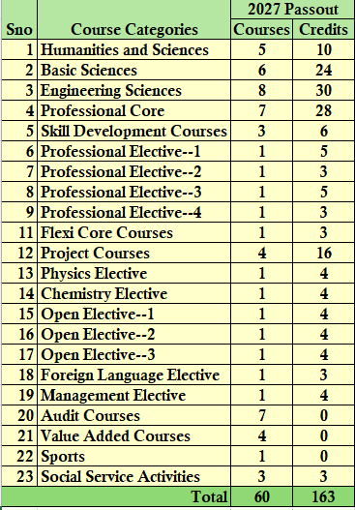
Y23 Academic Regulation- Graduation Requirements-B.Tech (CSE) Program
Note: Those students aiming for an Honors Degree will be completing an additional 20 credits from the Honors specific Buckets

Slide 3
Registration Process
Step 1: Log in to your ERP Account and ensure that there are no dues.
Step 2: Connect with your counsellor through a Microsoft Teams account and follow the guidelines
Step 3: Decide on your Cluster (1 or 2) based on the Specialization (Finalized from dept)
Step 4: Select your courses in the same cluster carefully based on your specific requirements, and avoid comparing them with those of other students, as the courses are tailored to meet individual needs. Ensure that you select all components (L, T, P, S) based on the course structure without missing any component. Cross-cluster selections may result in timetable clashes, and registration will not be successful.
Step 5: After selecting courses in all categories, review the displayed timetable carefully and then submit. Step—6. Log out and Log in to ERP to check your TT again.

Slide 4
Registration Process
Check the Dues in your ERP, pay the required fee through ERP and ensure no Due is reflected in your account.
Send the Receipts to your counsellors today or show it to the counsellor before the registration.
Decide your Courses Carefully and be ready for the registrations.
On the day of registration, do the registrations online with proper guidance.
Thoroughly Check the courses you have selected before submitting the registration form
Check the Coursera Fee& VAC Fee in ERP and pay Accordingly (Rs. 6000/-per Year &Rs1000 per Course).

Slide 5
Course Categories
C - 0
C - 1
C - 2
C - 3
C - 4
Humanities & BASIC SCIENCES
SKILL DEVELOP.
Basic Sciences (Maths)
PE-1
Flexi Core
C - 5
C - 6
C - 7
C - 8
C - 9
Science Elective-1
HONORS FLEXI CORE
Value Added
PCC
GBLP

Slide 6
Cluster Selection (Very Important )
Cluster—1 | Cluster—2
Section Nos starting from 101,102… | Section Nos starting from 201,202…
All Cloud Specializations (E05) | All AI Specializations(E02)
All Security Specializations(E09) | All Data Communication Specializations(E07)
All Gaming and UX Design Specializations(E17) | All Data Science Specializations(E11)
Software Modelling and DevOps(E27) | All Embedded Systems Specializations
Cross Platform Development Specializations(E16)

Slide 7
For All Students
C - 0
BASIC SCIENCES
CHOICE | CODE | NAME | L | T | P | S | CR | CH
Mandatory | 23UC0031 | LEADERSHIP AND MANAGEMENT SKILLS | 0 | 0 | 4 | 0 | 2 | 4

Slide 8
For All Students
C - 1
SKILL DEVELOPMENT
CHOICE | CODE | NAME | L | T | P | S | CR | CH
Mandatory | 23SDCS13A | CONTINUOUS INTEGRATION / CONTINUOUS DELIVERY AND CLOUD DEV OPS (CI /CD) | 0 | 0 | 6 | 4 | 4 | 10
All Students Must Register without fail.

Slide 9
For All Students
C - 2
Basic Sciences (Math)
CHOICE | CODE | NAME | L | T | P | S | CR | CH
Choose a Course which is not Registered in Earlier Semesters | 23MT2004 | MATHEMATICAL PROGRAMMING | 2 | 2 | 0 | 0 | 4 | 4
 | 23MT2005 | PROBABILITY, STATISTICS & QUEUEING THEORY | 2 | 2 | 0 | 0 | 4 | 4
 | 23MT2014 | THEORY OF COMPUTATION | 2 | 2 | 0 | 0 | 4 | 4
All Students Must Register one course under this bucket without fail.

Slide 10
Selection Based on Specialization
C - 3
PE-1
CLOUD NATIVE SOFTWARE ENGINEERING SPECIALIZATION (Cluster—1 )
CODE | NAME | L | T | P | S | CR | CH
23CNE3101A | FOUNDATIONS OF CLOUD NATIVE COMPUTING | 4 | 0 | 4 | 4 | 7 | 12
CROSS PLATFORM DEVELOPMENT FRAMEWORKS SPECIALIZATION (Cluster—1 )
CODE | NAME | L | T | P | S | CR | CH
23CPD3101A | FUNDAMENTALS OF MOBILE APPLICATION DEVELOPMENT | 4 | 0 | 4 | 4 | 7 | 12
CYBER SECURITY AND BLOCKCHAIN TECHNOLOGY SPECIALIZATION (Cluster—1 )
CODE | NAME | L | T | P | S | CR | CH
23CSB3101A | CRYPT ANALYSIS & CYBER DEFENSE | 4 | 0 | 4 | 4 | 7 | 12
BLOCKCHAIN ENGINEERING FOR WEB3 SPECIALIZATION (Cluster—1)
CODE | NAME | L | T | P | S | CR | CH
23BEW3101A | INTRODUCTION TO BLOCKCHAIN TECHNOLOGY, CRYPTOCURRENCIES AND TOKENS | 4 | 0 | 4 | 4 | 7 | 12

Slide 11
Selection Based on Specialization
C - 3
PE-1
CLOUD AND EDGE COMPUTING SPECIALIZATION (Cluster—1)
CODE | NAME | L | T | P | S | CR | CH
23CEC3101A | CLOUD INFRASTRUCTURE AND SERVICES | 4 | 0 | 4 | 4 | 7 | 12
DISTRIBUTED LEDGER ANALYTICS SPECIALIZATION (Cluster—1)
CODE | NAME | L | T | P | S | CR | CH
23DLA3101A | SYSTEM & NETWORK TRAFFIC SECURITY ANALYTICS | 4 | 0 | 4 | 4 | 7 | 12
CLOUD INFRASTRUCTURE DESIGN AND ENGINEERING SPECIALIZATION (Cluster—1)
CODE | NAME | L | T | P | S | CR | CH
23CID3101A | CLOUD INFRASTRUCTURE ENGINEERING | 4 | 0 | 4 | 4 | 7 | 12
GAME DEVELOPMENT AND UX DESIGN SPECIALIZATION (Cluster—1 )
CODE | NAME | L | T | P | S | CR | CH
23GDU3101A | PROGRAMMING FOR GAME DEVELOPMENT | 4 | 0 | 4 | 4 | 7 | 12

Slide 12
Selection Based on Specialization
C - 3
PE-1
AI & AUTONOMOUS SYSTEMS SPECIALIZATION (Cluster—2 )
CODE | NAME | L | T | P | S | CR | CH
23AAS3102A | AI & CONTROLS FOR AUTONOMOUS FUTURE TRANSPORT | 4 | 0 | 4 | 4 | 7 | 12
AI FOR COMPUTATIONAL INTELLIGENCE SPECIALIZATION (Cluster—2 )
CODE | NAME | L | T | P | S | CR | CH
23ACI3101A | GENERATIVE ADVERSARIAL NETWORKS | 4 | 0 | 4 | 4 | 7 | 12
AI SYSTEMS FOR VISUAL INTELLIGENCE SPECIALIZATION (Cluster—2 )
CODE | NAME | L | T | P | S | CR | CH
23AVI3101A | DEEP LEARNING | 4 | 0 | 4 | 4 | 7 | 12
AI DRIVEN EDGE ARCHITECTURES AND APPLICATIONS SPECIALIZATION (Cluster—2 )
CODE | NAME | L | T | P | S | CR | CH
23ADE3101A | EDGE COMPUTING FUNDAMENTALS | 4 | 0 | 4 | 4 | 7 | 12

Slide 13
Selection Based on Specialization
C - 3
PE-1
AI DRIVEN LANGUAGE TECHNOLOGIES SPECIALIZATION (Cluster—2 )
CODE | NAME | L | T | P | S | CR | CH
23ALT3101A | APPLIED MACHINE LEARNING FOR TEXT ANALYSIS | 4 | 0 | 4 | 4 | 7 | 12
DATA ENGINEERING FOR AI SPECIALIZATION (Cluster—2 )
CODE | NAME | L | T | P | S | CR | CH
23DEA3101A | FUNDAMENTALS OF DATA ENGINEERING | 4 | 0 | 4 | 4 | 7 | 12
EMBEDDED SYSTEMS & IOT SPECIALIZATION (Cluster—2 )
CODE | NAME | L | T | P | S | CR | CH
23EDS3101R | ADVANCED EMBEDDED SYSTEMS | 4 | 0 | 4 | 4 | 7 | 12
DATA SCIENCE AND BIG DATA ANALYTICS SPECIALIZATION (Cluster—2 )
CODE | NAME | L | T | P | S | CR | CH
23DSB3101A | DATA ANALYTICS AND VISUALIZATION | 4 | 0 | 4 | 4 | 7 | 12

Slide 14
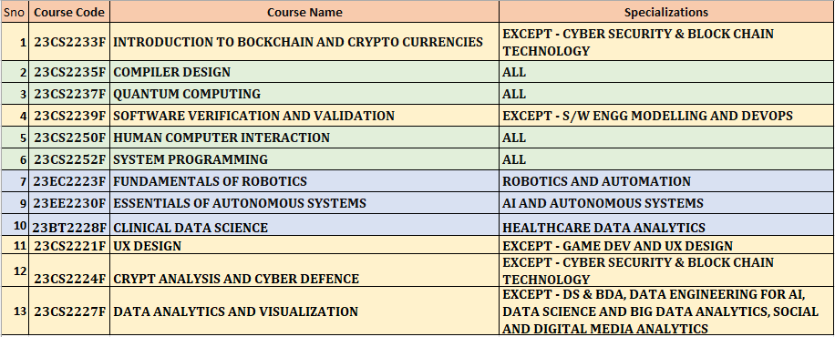
C - 4
Selection Based on Specialization
Flexi Core
CHOICE | CODE | NAME | L | T | P | S | CR | CH
SPEC |  | FLEXI CORE (only for Non-Acceleration) | 2 | 0 | 2 | 0 | 3 | 4
Only for Non-Acceleration Students

Slide 15
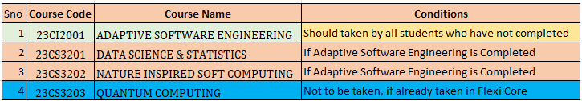
Only for Non-Acceleration Students
C - 5
Science Elective-1
CHOICE | CODE | NAME | L | T | P | S | CR | CH
Only one |  | PCC | 3 | 1 | 0 | 0 | 4 | 4
 |  | Science Elective | 2 | 2 | 0 | 0 | 4 | 4
Only for Non-Acceleration Students

Slide 16
Choice for Honors Outcome
C - 6
HONORS FLEXI CORE
CHOICE | CODE | NAME | L | T | P | S | CR | CH
Any One | 23CS03HF | ADVANCED ALGORITHMS & DATA STRUCTURES | 3 | 0 | 2 | 0 | 4 | 5
 | 23CS02HF | EMBEDDED SYSTEMS DESIGN | 3 | 0 | 2 | 0 | 4 | 5
 | 23CS04HF | HIGH PERFORMANCE COMPUTING | 3 | 0 | 2 | 0 | 4 | 5
Note: This category is only for those students aiming for Honors degree

Slide 17
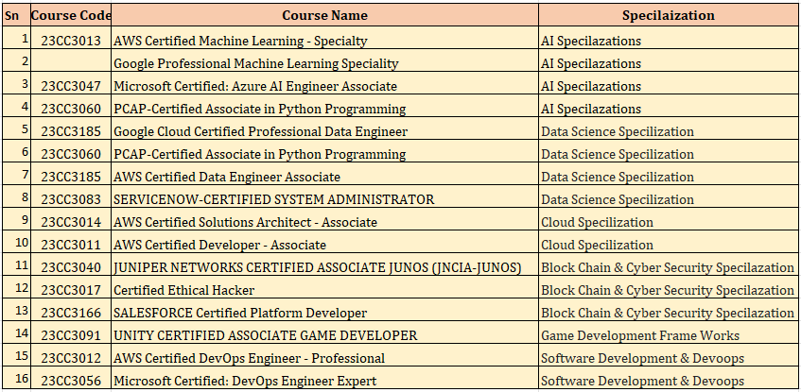
For All Students
C - 7
Value Added
 | CODE | NAME | L | T | P | S | CR | CH
 |  | Value Added | 0 | 0 | 0 | 8 | 0 | 8

Slide 18
For all Non-Acceleration Students
C - 8
PCC
 | CODE | NAME | L | T | P | S | CR | CH
 | 23CS4106 | DISTRIBUTED COMPUTING | 2 | 0 | 0 | 0 | 2 | 2

Slide 19
C - 9
GBLP
CHOICE | CODE | NAME | L | T | P | S | CR | CH
 | 23UC0013 | Global Logic Design Practicum | 0 | 0 | 2 | 0 | 1 | 2
Note: This should be registered for students who have not completed GBLP (Detained) in 2-1 and 2-2

Slide 20
Important Contacts
 | Counsellor | CSE-2 | Primary Contact
1 | Mr.M.CHANDAN | CSE-2 | Y23 Professor In-charge | 9491115961 | mcchakravarthy@kluniversity.in | Y23 CSE-2
2 | Dr.MOTHUKURI RADHA | CSE-2 | Y23 Cunselling Professor In-charge | 9848659298 | radha@kluniversity.in | Y23 CSE-2
3 | Ms. ANUMULA SRUTHI | CSE-2 | ERP Incharge Y23 | 9492888150 | asruthi@kluniversity.in | Y23 CSE-2
4 | Mr. RAJESH TULASI | CSE-2 | Registrations member Y23 | 9441075108 | rajeshtulasi@kluniversity.in | Y23 CSE-2
5 | Ms. PUNYALA RAMADEVI | CSE-2 | Registrations member Y23 | 7993752406 | pramadevi@kluniversity.in | Y23 CSE-2
6 | Dr. T CHITHRAKUMAR | CSE-2 | Registrations member Y23 | 7200464709 | tchithrakumar@kluniversity.in | Y23 CSE-2
7 | Dr. P PRABAKARAN | CSE-2 | Registrations member Y23 | 9842459808 | pprabakaran@kluniversity.in | Y23 CSE-2
8 | Dr.KVD Kiran | CSE-2 | Alternate HOD | 9985528099 | kiran_cse@kluniversity.in | Y23 CSE-2
 | Dr.B. Tirapathi Reddy | CSE-2 | HOD | 8099721265 | tirapathireddyb@kluniversity.in | Y23 CSE-2

Slide 21
Thank you! Best Wishes for the upcoming
Academic Year 2025-26

